Slide 1
SSW-555: Agile Methods for Software Development
Course Review
Prof. Jim Rowland
Software Engineering
School of Systems and Enterprises

Slide 2

Software project challenges
Feasibility and profitability – Should the project be done?
Requirements – What needs to be done?
Planning and controlling – Who does what and when?
Implementation – Creating the software
Delivery and maintenance – Delivery to users, responding to needed changes
Support – Environment and tools needed for project
Teamwork – Making sure everyone is on the same page

Slide 3
Software development before Agile
1960s:
Original software crisis leads to "software engineering”
Apply techniques from other engineering disciplines to software
1970s:
Adoption of traditional engineering methods, such as the waterfall model
1980s:
Many attacks on complexity (OO, CASE tools, formal methods, iterative process models, process maturity)
"No silver bullet" published by Brooks
Software market expands from DoD and large business to home PCs
1990s:
WWW, dot-com boom, and Internet time
Backlash against heavy process

Slide 4

Rational Unified Process (RUP)
Developed at Rational Software in late 1990s after acquisition of several Object-Oriented companies
Based on 6 Best Practices of Software Engineering
Develop iteratively
Manage requirements
Use component-based architectures
Model software visually (UML)
Continuously verify software quality
Control changes

Slide 5

Agile Manifesto
We are uncovering better ways of developing software by doing it and helping others do it.
Through this work we have come to value:
Individuals and interactions over processes and tools
Working software over comprehensive documentation
Customer collaboration over contract negotiation
Responding to change over following a plan
That is, while there is value in the items on the right, we value the items on the left more.
The DevOps Manifesto expands the Agile Manifesto to include DevOps issues

Slide 6
Principles of Agile Methods
Satisfy the customer through frequent delivery
Welcome changing requirements
Businesspeople and developers work together
Motivated people working at sustainable pace
Face-to-face communication
Continuous attention to technical quality
Simplicity
Self-organizing teams
Regular reflection

Slide 7
Different Agile Methods
Extreme Programming
Scrum
Lean
DSDM
FDD
Crystal
SAF
Spotify
DevOps
(and many others)
Similarities among and differences between methods

Slide 8
Different practices
User stories
Testing
Unit, regression, TDD, BDD
Pair programming
Refactoring
Continuous integration
Code ownership
Kanban boards
JAD
Inspections
Crystal strategies and techniques
(and many others)

Slide 9
Size matters
Large systems cannot be created easily by small teams
Larger teams require more planning and control
Some practices, such as impromptu face-to-face communication, don't scale well
Need to find other ways to coordinate between teams
Need to allow cross-fertilization across teams
Impossible to make all tasks independent
Dependencies must be managed

Slide 10
Other things matter, too
Most software development is maintenance
Need to include operations and customer support
Long-term planning is needed
Some systems have higher risks than others
Special practices may be needed
Starting and maintaining a software development project is as least as difficult as developing the software
Need to establish relationships with all important stakeholders
Need to understand the market
Coordination of effort requires constant vigilance

Slide 11

Extreme Programming (XP)
XP’s 12 Practices
The Planning Game
Small releases
Metaphor
Simple design
Testing
Refactoring
Pair programming
Collective ownership
Continuous integration
Sustainable pace
Whole team
Coding standards

Slide 12
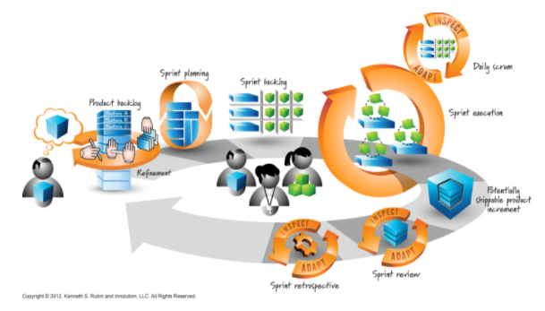
Scrum Process
“Standup meeting”
http://www.innolution.com/essential-scrum/table-of-contents/chapter-2-scrum-framework

Slide 13

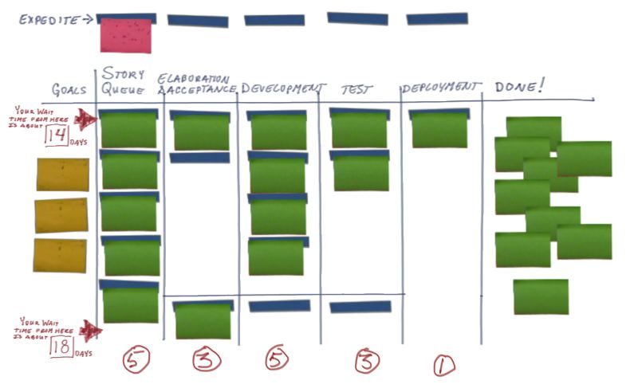
Lean
Toyota’s need for a better manufacturing process
Toyota’s 7 Principles of Lean
Eliminate waste, Amplify learning,
Decide as late as possible, Deliver as fast a possible,
Empower the team, Build integrity in, See the whole
Lean practices
Value stream mapping
Set-based development
Pull systems (Just In Time)
Kanban boards

Slide 14
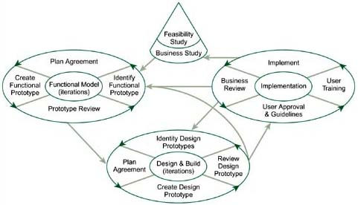
RAD/DSDM Process
Start Here
Source: Highsmith chapter 18
Rapid (RAD)
Changing customer-supplier model
In house development groups
Time boxed, incremental deliveries
Trade features for time
Small teams
Case Tools
DSDM
Formalized RAD
Time boxing
Strict schedules
Drop features but don’t miss deadline
Evolutionary prototyping:
MoSCoW
80/20 rule
Facilitated Joint Workshops (JAD)

Slide 15
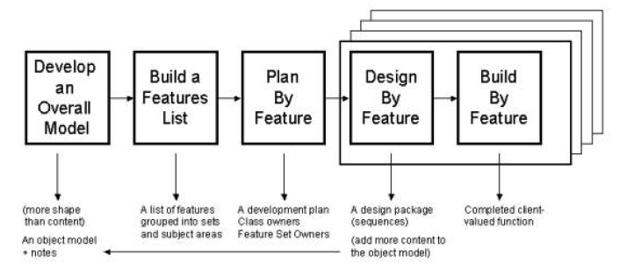
Feature Driven Development
Scale Agile to large projects
Jedi (Just Enough Design Initially) approach
Not BDUF (Big Design Up Front) as in Plan driven approaches
source: Palmer2013

Slide 16
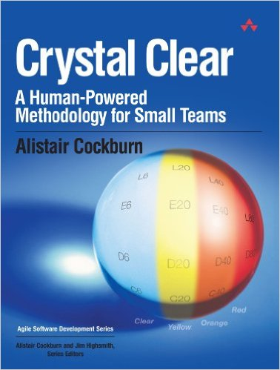
Crystal
Alistair Cockburn’s family of Crystal methods
Add rigor to scale from small to large projects
Crystal Clear, Yellow, Orange, Red
Properties, techniques, and strategies
Borrowed from XP and adapted
Osmotic communication, early victory, walking skeleton, …
Roles and work products
Sponsor, team, coordinator/manager
Business expert, lead designer, tester, designer/programmer, writer

Slide 17
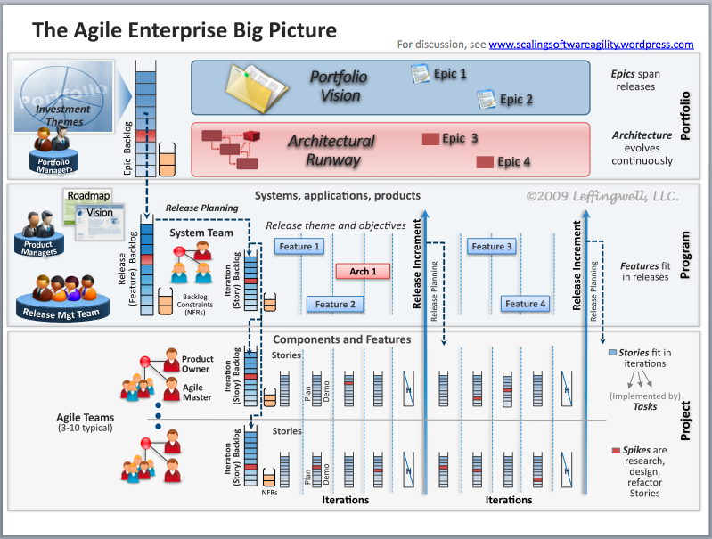
Scaled Agile Framework

Slide 18
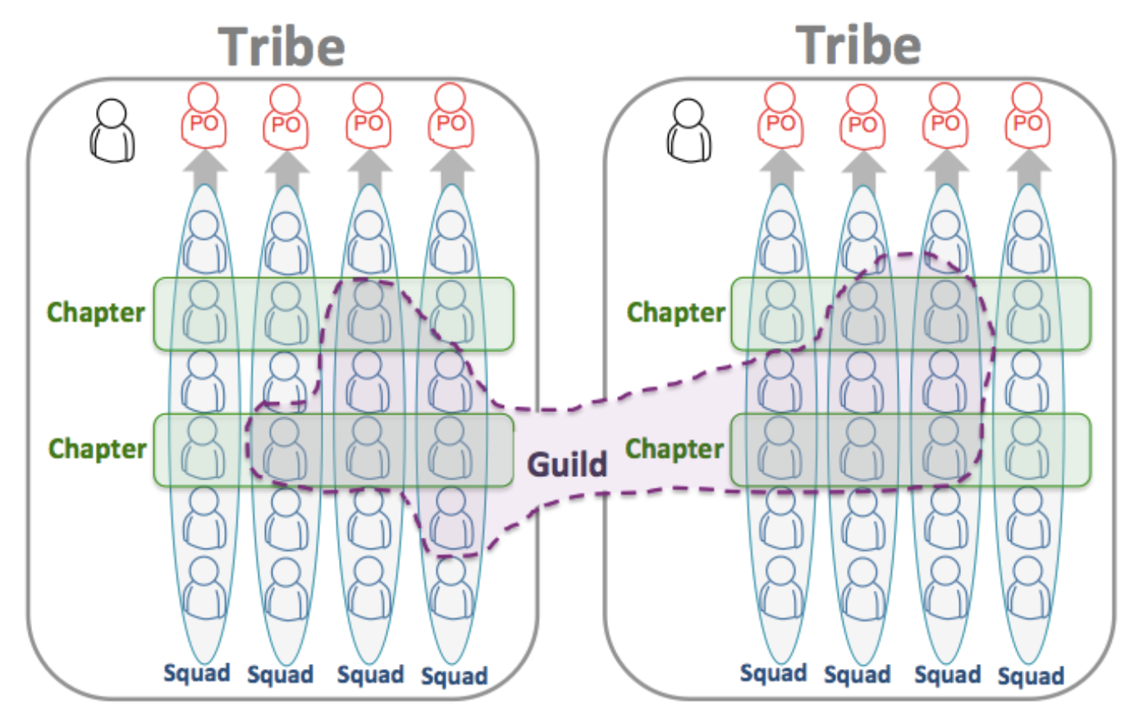
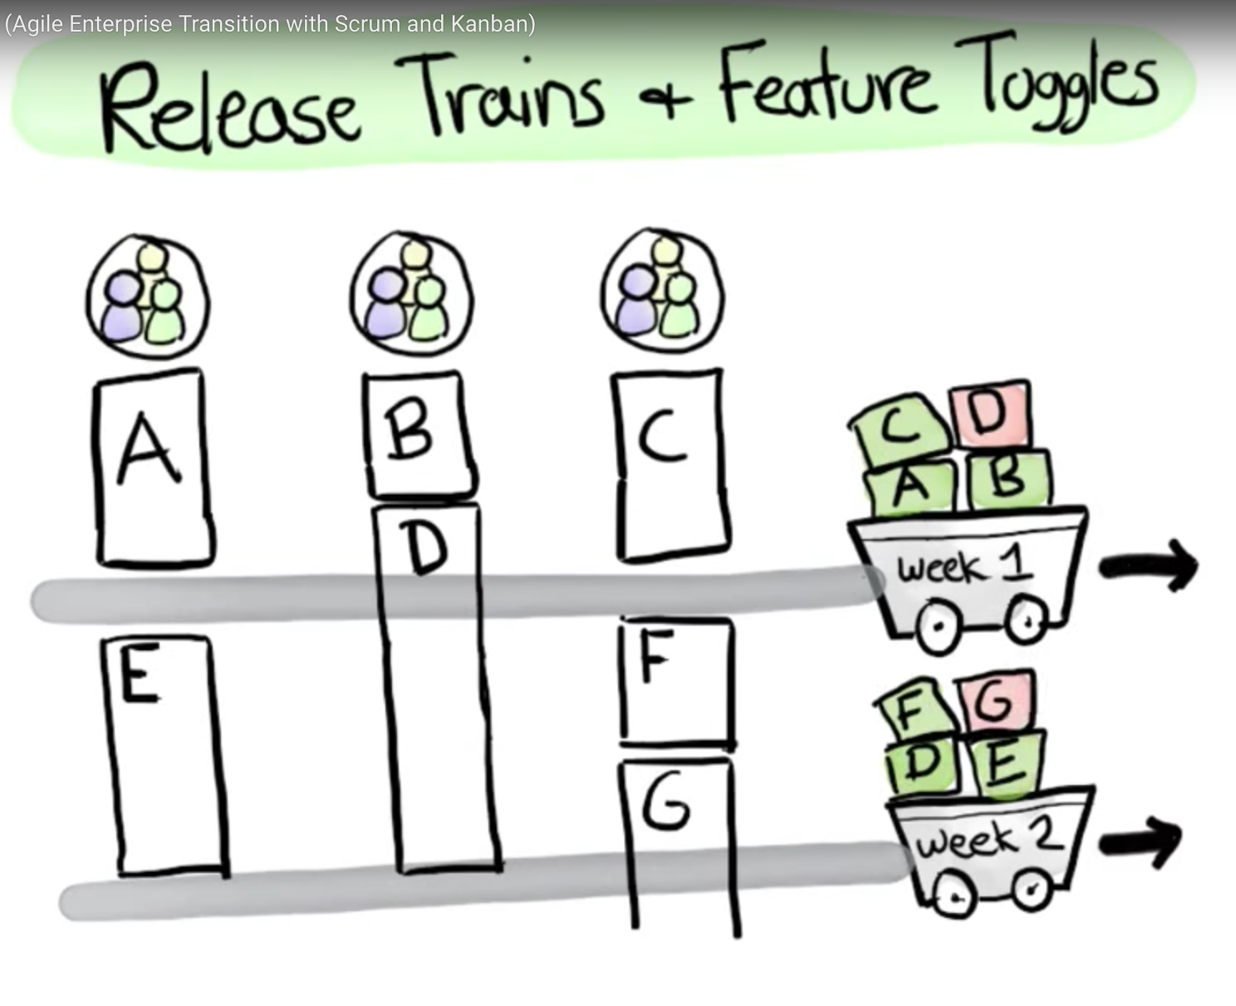
Agile Methods at Spotify

Slide 19
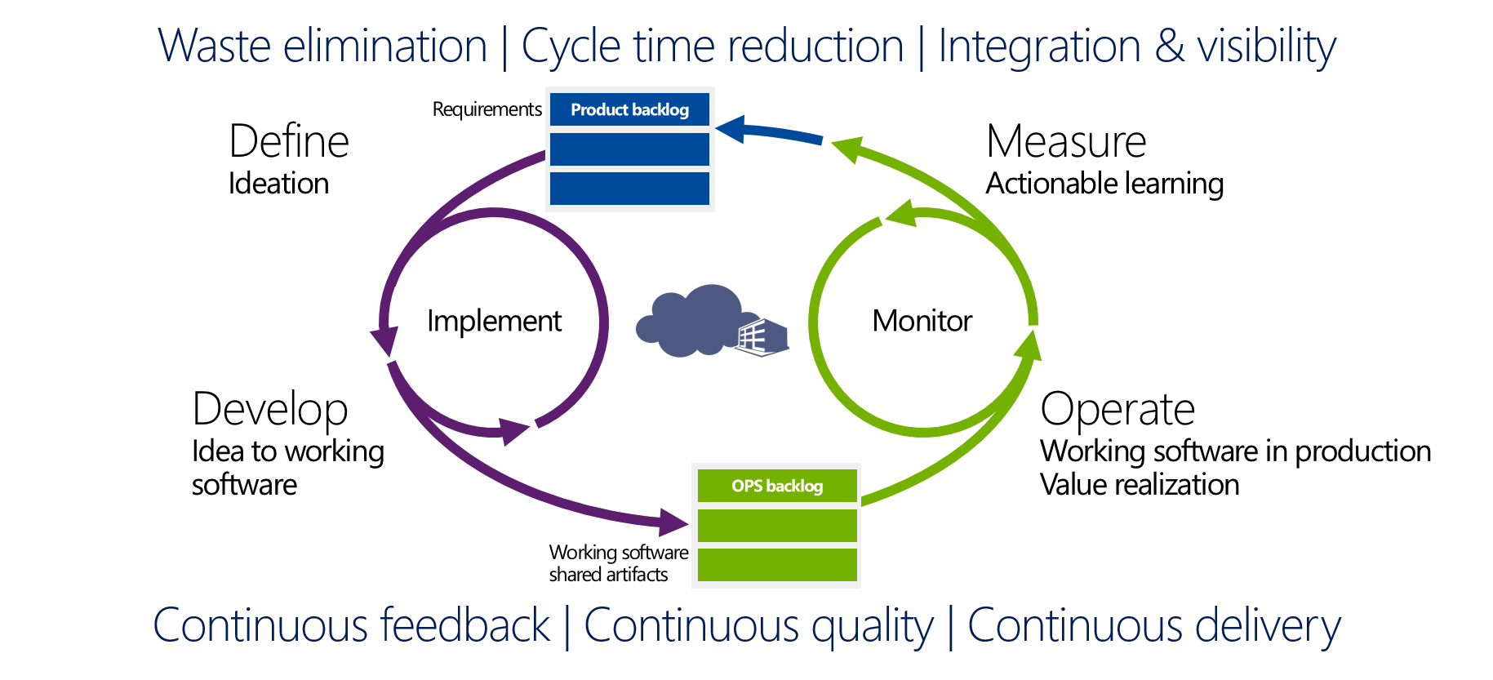
DevOps
Source: http://incyclesoftware.com/wp-content/uploads/2013/01/modern-release-cycle.png

Slide 20
Achieving DevOps: CALMS
Culture
Empowered teams
Shared responsibilities
Automation
Automate everything
Lean
Continuous improvement
Eliminate waste
Monitoring
Measure and report everything
Sharing
Share learnings across the organization

Slide 21

Questions?

Slide 22

Good luck on the final exam!

